Slide 1
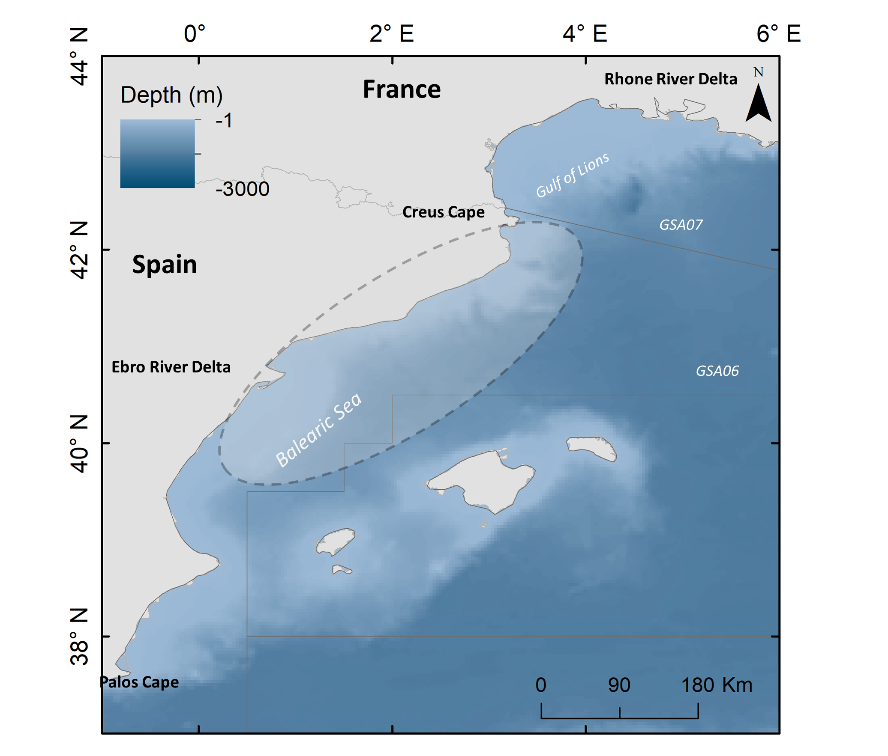
Marta Coll & Miquel Ortega

Slide 2
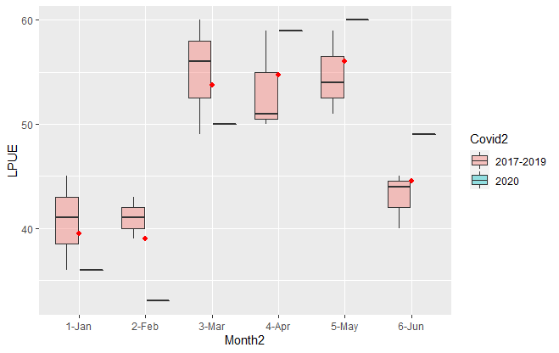
LPUE (landings productivity)
Call:
glm(formula = LPUE ~ Covid, family = gaussian, data = data6)
Deviance Residuals:
Min 1Q Median 3Q Max
-13.7143 -5.8690 0.2857 4.2857 13.2857
Coefficients:
Estimate Std. Error t value Pr(>|t|)
(Intercept) 46.714 1.710 27.318 <2e-16 ***
CovidYes 9.619 4.837 1.989 0.0593 .
---
Signif. codes: 0 ‘***’ 0.001 ‘**’ 0.01 ‘*’ 0.05 ‘.’ 0.1 ‘ ’ 1
(Dispersion parameter for gaussian family taken to be 61.40693)
Null deviance: 1593.8 on 23 degrees of freedom
Residual deviance: 1351.0 on 22 degrees of freedom
AIC: 170.84
Number of Fisher Scoring iterations: 2
Aristeus antennatus

Slide 3
Call:
glm(formula = LPUE ~ Covid, family = quasipoisson(), data = data6)
Deviance Residuals:
Min 1Q Median 3Q Max
-2.11914 -0.85563 0.03969 0.61781 1.86116
Coefficients:
Estimate Std. Error t value Pr(>|t|)
(Intercept) 3.84405 0.03647 105.417 <2e-16 ***
CovidYes 0.18724 0.09512 1.968 0.0618 .
---
Signif. codes: 0 ‘***’ 0.001 ‘**’ 0.01 ‘*’ 0.05 ‘.’ 0.1 ‘ ’ 1
(Dispersion parameter for quasipoisson family taken to be 1.304442)
Null deviance: 33.630 on 23 degrees of freedom
Residual deviance: 28.795 on 22 degrees of freedom
AIC: NA
Number of Fisher Scoring iterations: 4

Slide 4
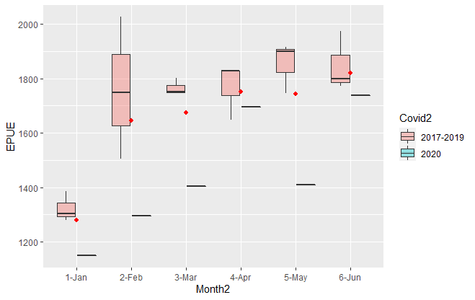
EPUE (economic productivity)
Call:
glm(formula = EPUE ~ Covid, family = gaussian, data = data8)
Deviance Residuals:
Min 1Q Median 3Q Max
-524.71 -116.93 73.79 154.29 352.29
Coefficients:
Estimate Std. Error t value Pr(>|t|)
(Intercept) 1673.71 53.42 31.333 <2e-16 ***
CovidYes -170.05 151.09 -1.125 0.273
---
Signif. codes: 0 ‘***’ 0.001 ‘**’ 0.01 ‘*’ 0.05 ‘.’ 0.1 ‘ ’ 1
(Dispersion parameter for gaussian family taken to be 59922.23)
Null deviance: 1394194 on 23 degrees of freedom
Residual deviance: 1318289 on 22 degrees of freedom
AIC: 336.04
Number of Fisher Scoring iterations: 2
Aristeus antennatus

Slide 5
Call:
glm(formula = EPUE ~ Covid, family = quasipoisson(), data = data8)
Deviance Residuals:
Min 1Q Median 3Q Max
-13.602 -2.999 1.790 3.715 8.333
Coefficients:
Estimate Std. Error t value Pr(>|t|)
(Intercept) 7.42280 0.03199 232.024 <2e-16 ***
CovidYes -0.10714 0.09486 -1.129 0.271
---
Signif. codes: 0 ‘***’ 0.001 ‘**’ 0.01 ‘*’ 0.05 ‘.’ 0.1 ‘ ’ 1
(Dispersion parameter for quasipoisson family taken to be 35.97244)
Null deviance: 872.14 on 23 degrees of freedom
Residual deviance: 824.97 on 22 degrees of freedom
AIC: NA
Number of Fisher Scoring iterations: 4

Slide 6
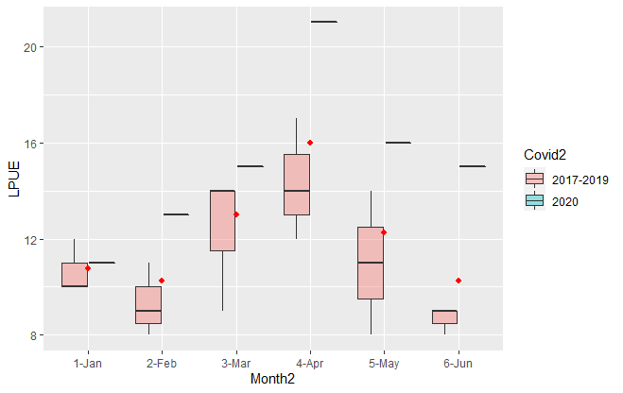
LPUE (landings productivity)
Call:
glm(formula = LPUE ~ Covid, family = gaussian, data = data7)
Deviance Residuals:
Min 1Q Median 3Q Max
-3.3333 -2.3333 -0.3333 2.6667 5.6667
Coefficients:
Estimate Std. Error t value Pr(>|t|)
(Intercept) 11.3333 0.5836 19.421 2.46e-15 ***
CovidYes 6.0000 1.6506 3.635 0.00146 **
---
Signif. codes: 0 ‘***’ 0.001 ‘**’ 0.01 ‘*’ 0.05 ‘.’ 0.1 ‘ ’ 1
(Dispersion parameter for gaussian family taken to be 7.151515)
Null deviance: 251.83 on 23 degrees of freedom
Residual deviance: 157.33 on 22 degrees of freedom
AIC: 119.24
Number of Fisher Scoring iterations: 2
Parapenaeus longirostris

Slide 7
Call:
glm(formula = LPUE ~ Covid, family = quasipoisson(), data = data7)
Deviance Residuals:
Min 1Q Median 3Q Max
-1.04583 -0.71919 -0.09951 0.76375 1.56604
Coefficients:
Estimate Std. Error t value Pr(>|t|)
(Intercept) 2.42775 0.05031 48.259 < 2e-16 ***
CovidYes 0.42488 0.11880 3.576 0.00168 **
---
Signif. codes: 0 ‘***’ 0.001 ‘**’ 0.01 ‘*’ 0.05 ‘.’ 0.1 ‘ ’ 1
(Dispersion parameter for quasipoisson family taken to be 0.6023242)
Null deviance: 20.062 on 23 degrees of freedom
Residual deviance: 13.040 on 22 degrees of freedom
AIC: NA
Number of Fisher Scoring iterations: 4

Slide 8
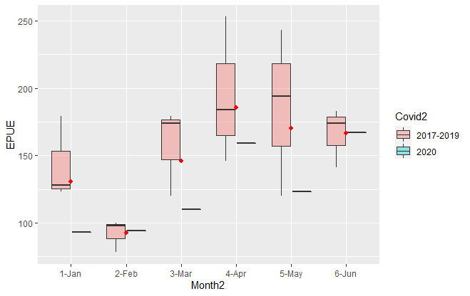
EPUE (economic productivity)
Call:
glm(formula = EPUE ~ Covid, family = gaussian, data = data9)
Deviance Residuals:
Min 1Q Median 3Q Max
-73.000 -31.000 -6.333 28.083 102.000
Coefficients:
Estimate Std. Error t value Pr(>|t|)
(Intercept) 151.00 10.16 14.859 5.94e-13 ***
CovidYes -20.33 28.74 -0.707 0.487
---
Signif. codes: 0 ‘***’ 0.001 ‘**’ 0.01 ‘*’ 0.05 ‘.’ 0.1 ‘ ’ 1
(Dispersion parameter for gaussian family taken to be 2168.758)
Null deviance: 48798 on 23 degrees of freedom
Residual deviance: 47713 on 22 degrees of freedom
AIC: 256.39
Number of Fisher Scoring iterations: 2
Parapenaeus longirostris

Slide 9
Call:
glm(formula = EPUE ~ Covid, family = quasipoisson(), data = data9)
Deviance Residuals:
Min 1Q Median 3Q Max
-6.5537 -2.6174 -0.5433 2.2589 7.5599
Coefficients:
Estimate Std. Error t value Pr(>|t|)
(Intercept) 5.01728 0.06744 74.394 <2e-16 ***
CovidYes -0.14463 0.20333 -0.711 0.484
---
Signif. codes: 0 ‘***’ 0.001 ‘**’ 0.01 ‘*’ 0.05 ‘.’ 0.1 ‘ ’ 1
(Dispersion parameter for quasipoisson family taken to be 14.42301)
Null deviance: 322.36 on 23 degrees of freedom
Residual deviance: 314.78 on 22 degrees of freedom
AIC: NA
Number of Fisher Scoring iterations: 4

